Slide 1

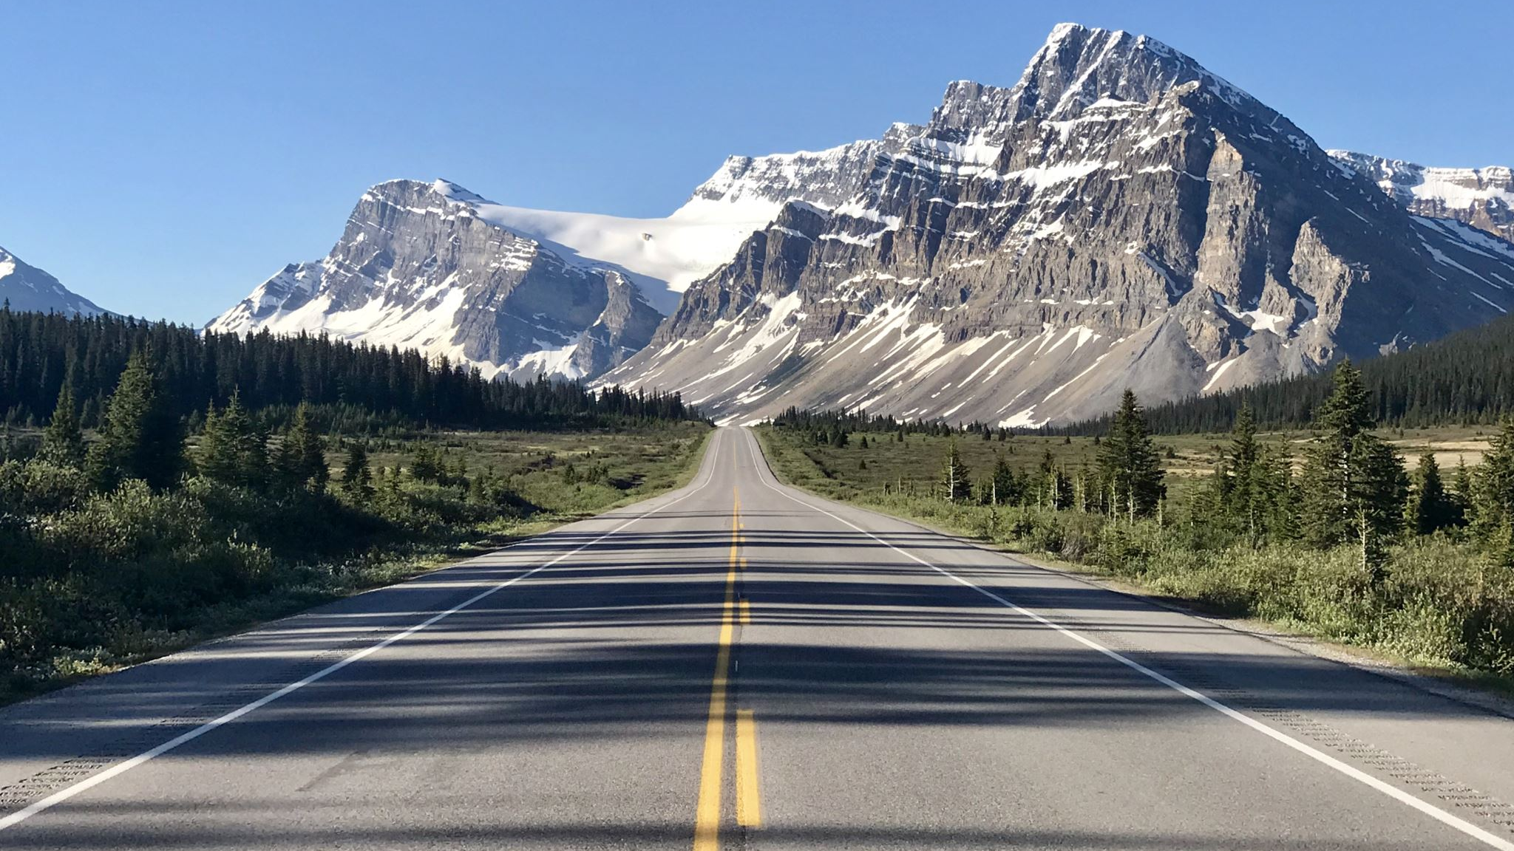
Path Finding for Alaskan Roads Depending on Season
Jason Kattenbraker
Justin Pirman

Slide 2




Big Problem
Alaskan road closures depend on season
Important road routes for emergencies
How does someone know where to go if they are not locals?
Determining the best route from any city

Slide 3
Methodology
Shortest path finding
Dijkstra's Algorithm
Floyd-Warshall All Shortest Pairs Algorithm
Johnson’s All Shortest Pairs Algorithm
Generate an undirected graph
Each city is a node, each road is an edge
(average speed limit) / (distance) = weight

Slide 4
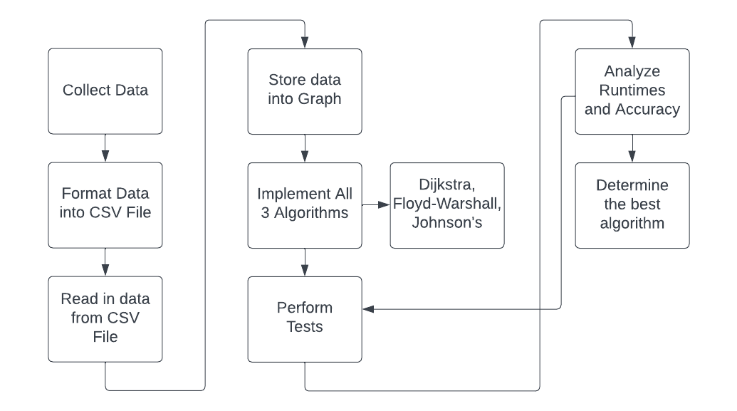
Block Diagram

Slide 5
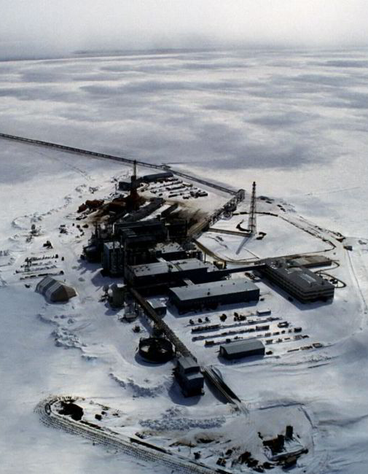
Dataset
37 cities/points of interest in testing
Cities with a high population
Towns/POI with interesting road conditions
Ex. Point Thomson only accessible in winter due to frozen bay becoming an ice road.
All nodes must have path to Anchorage
Average MPH and distance for each road is used as cost

Slide 6
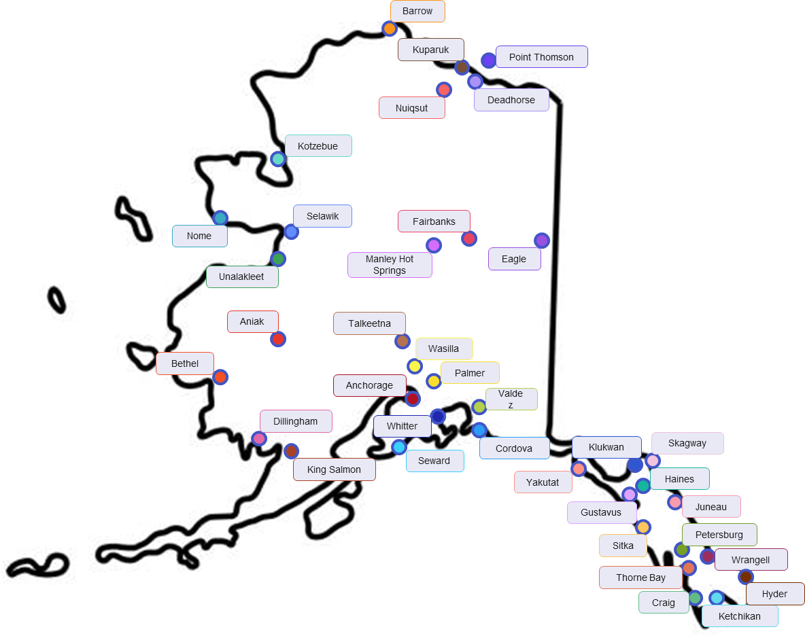
Alaska Cities
Legend
Legend
Anchorage
Hyder
Selawik
Aniak
Juneau
Seward
Barrow
Ketchikan
Sitka
Bethel
King Salmon
Skagway
Cordova
Klukwan
Talkeetna
Craig
Kotzebue
Thorne Bay
Deadhorse
Kuparuk
Unalakleet
Dillingham
Manley H.S.
Valdez
Eagle
Nome
Wasilla
Fairbanks
Nuiqsut
Whitter
Gustavus
Palmer
Wrangell
Haines
Petersburg
Yakutat
P. Thomson

Slide 7
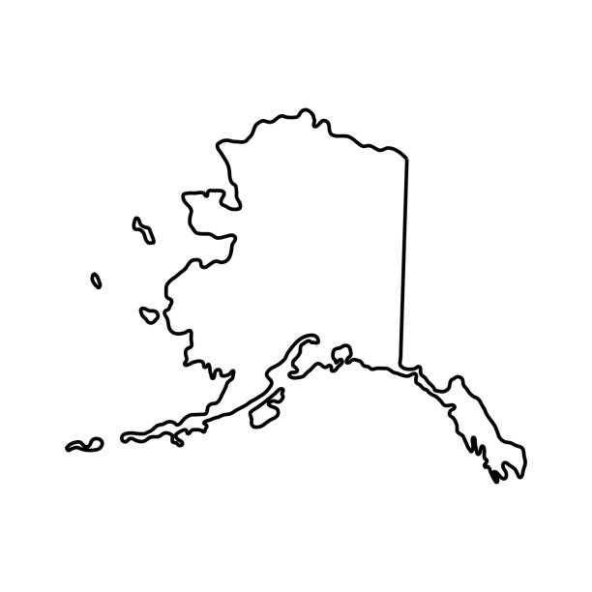
Road Closure
Seasons Open
Legend
Legend
All Year
Anchorage
Hyder
Selawik
Winter Only
Aniak
Juneau
Seward
Summer Only
Barrow
Ketchikan
Sitka
Bethel
King Salmon
Skagway
Cordova
Klukwan
Talkeetna
Craig
Kotzebue
Thorne Bay
Deadhorse
Kuparuk
Unalakleet
Dillingham
Manley H.S.
Valdez
Eagle
Nome
Wasilla
Fairbanks
Nuiqsut
Whitter
Gustavus
Palmer
Wrangell
Haines
Petersburg
Yakutat
P. Thomson

Slide 8
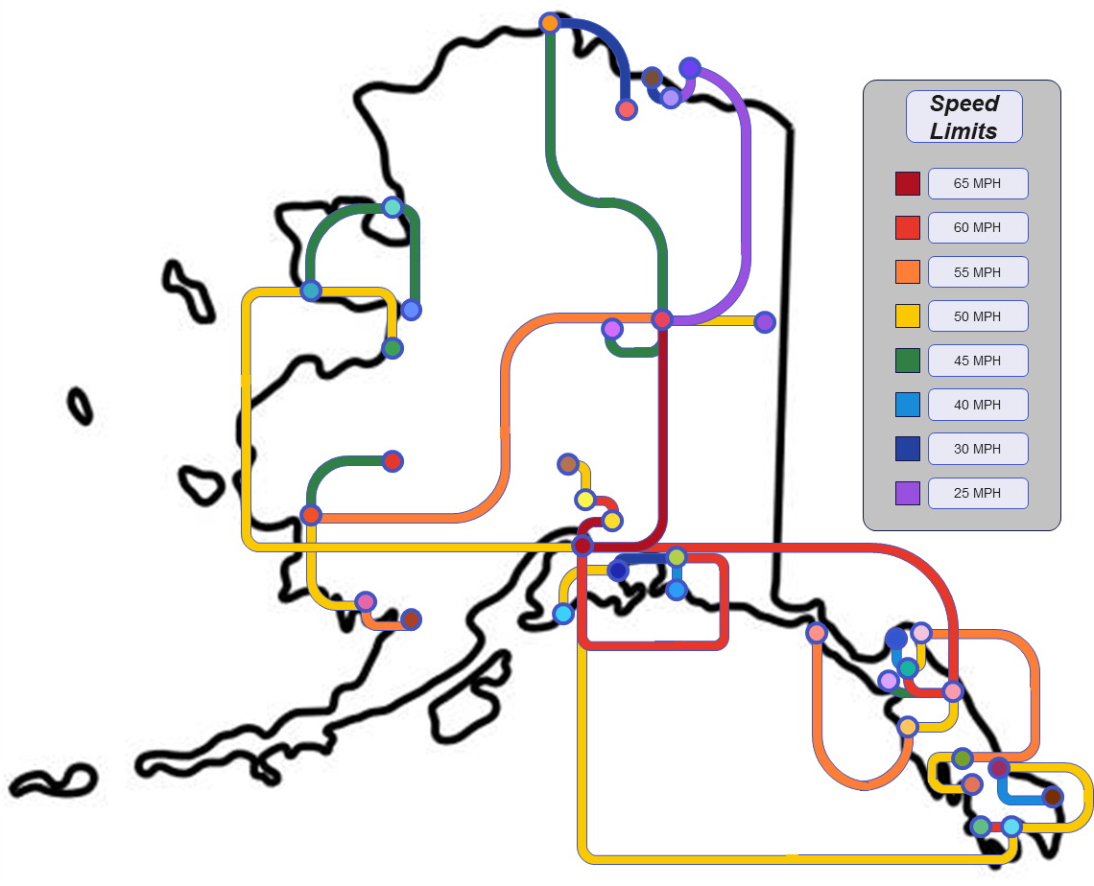
Speed Limits
Legend
Legend
Anchorage
Hyder
Selawik
Aniak
Juneau
Seward
Barrow
Ketchikan
Sitka
Bethel
King Salmon
Skagway
Cordova
Klukwan
Talkeetna
Craig
Kotzebue
Thorne Bay
Deadhorse
Kuparuk
Unalakleet
Dillingham
Manley H.S.
Valdez
Eagle
Nome
Wasilla
Fairbanks
Nuiqsut
Whitter
Gustavus
Palmer
Wrangell
Haines
Petersburg
Yakutat
P. Thomson

Slide 9
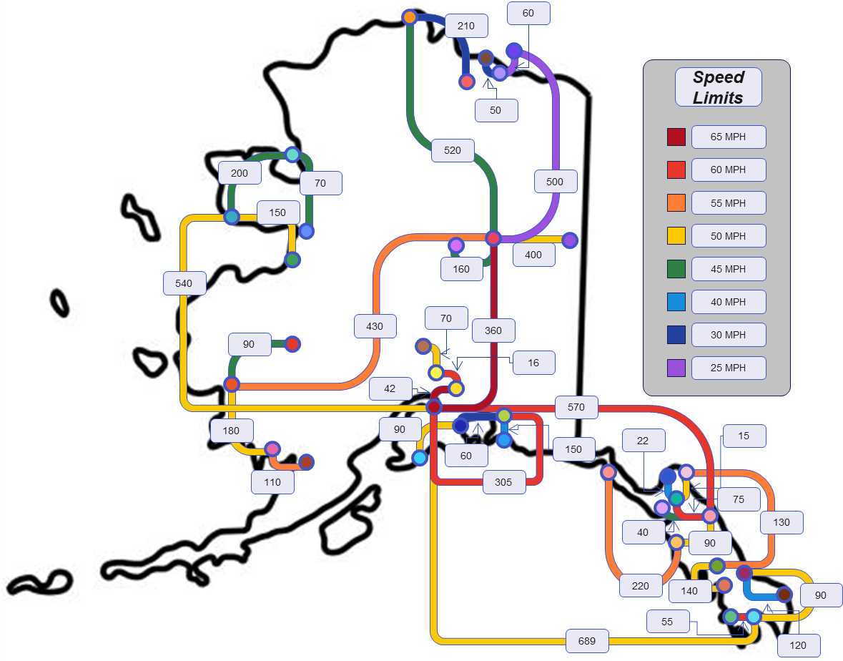
Speed Limits + Distance
Legend
Legend
Anchorage
Hyder
Selawik
Aniak
Juneau
Seward
Barrow
Ketchikan
Sitka
Bethel
King Salmon
Skagway
Cordova
Klukwan
Talkeetna
Craig
Kotzebue
Thorne Bay
Deadhorse
Kuparuk
Unalakleet
Dillingham
Manley H.S.
Valdez
Eagle
Nome
Wasilla
Fairbanks
Nuiqsut
Whitter
Gustavus
Palmer
Wrangell
Haines
Petersburg
Yakutat
P. Thomson

Slide 10
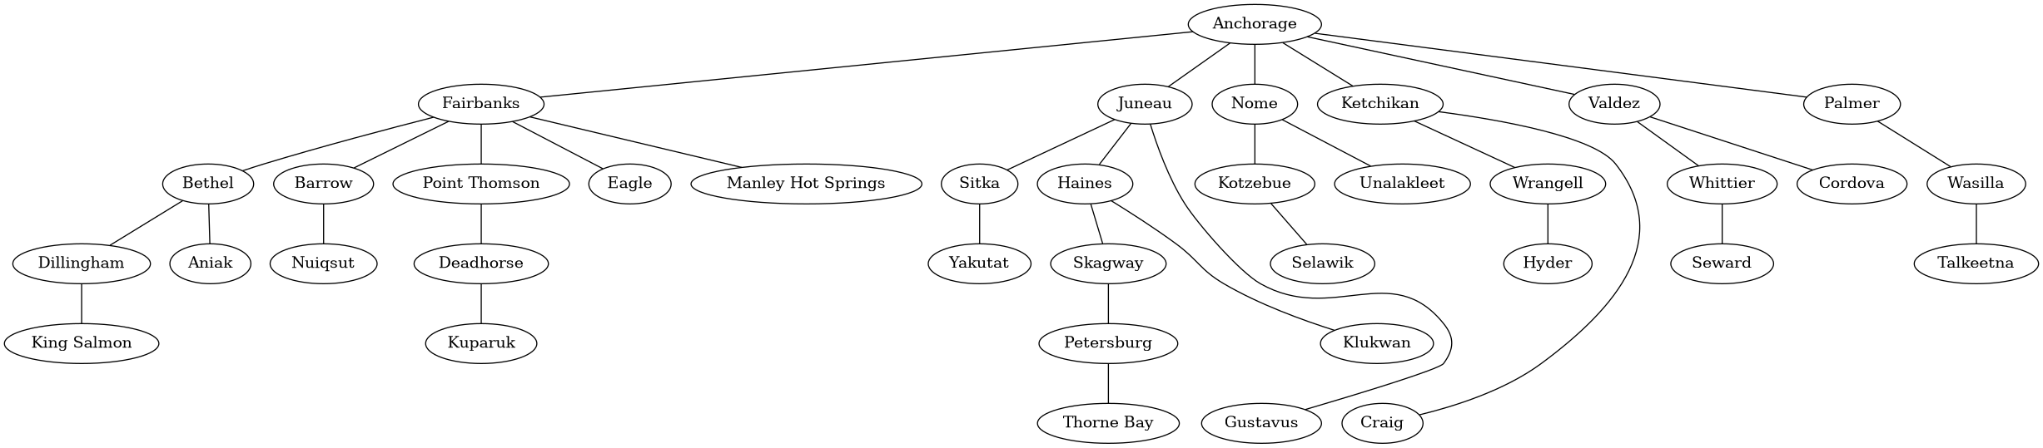
Graphical Representation using Graphviz

Slide 11
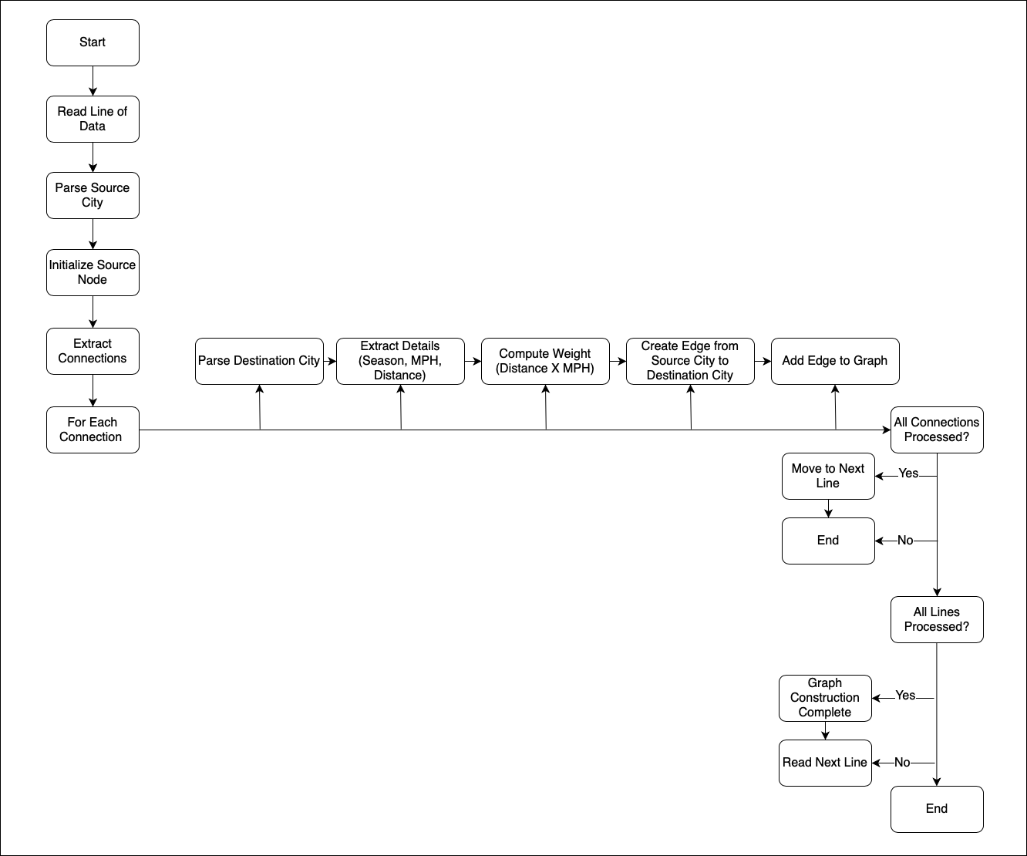

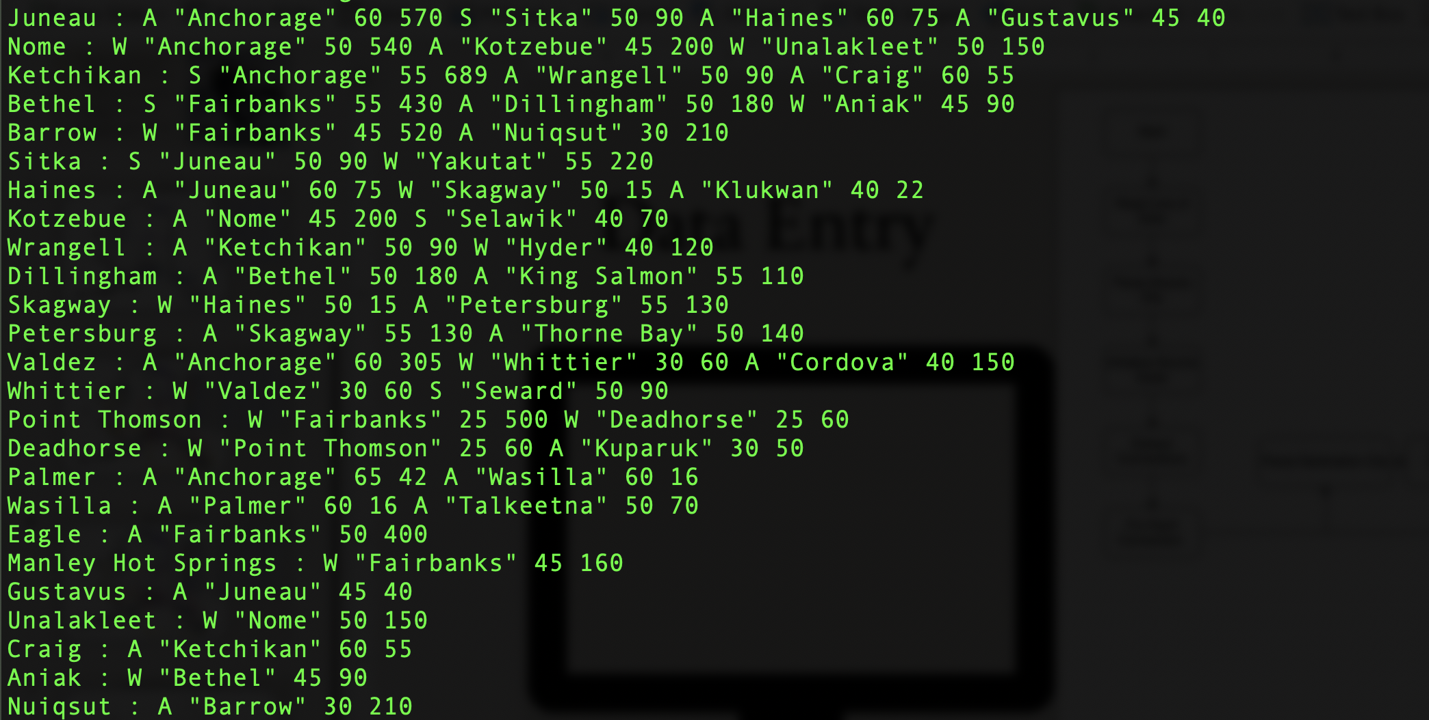
Data Entry

Slide 12
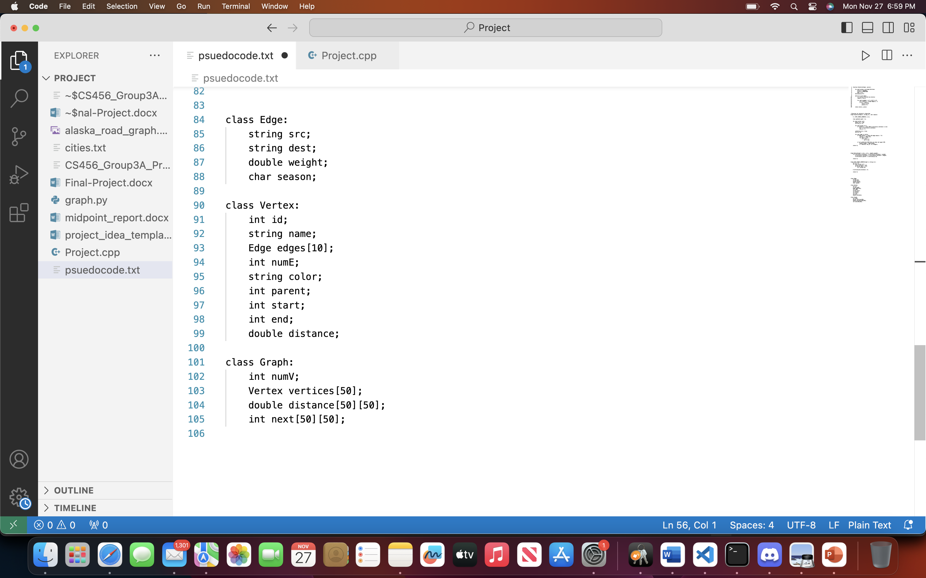
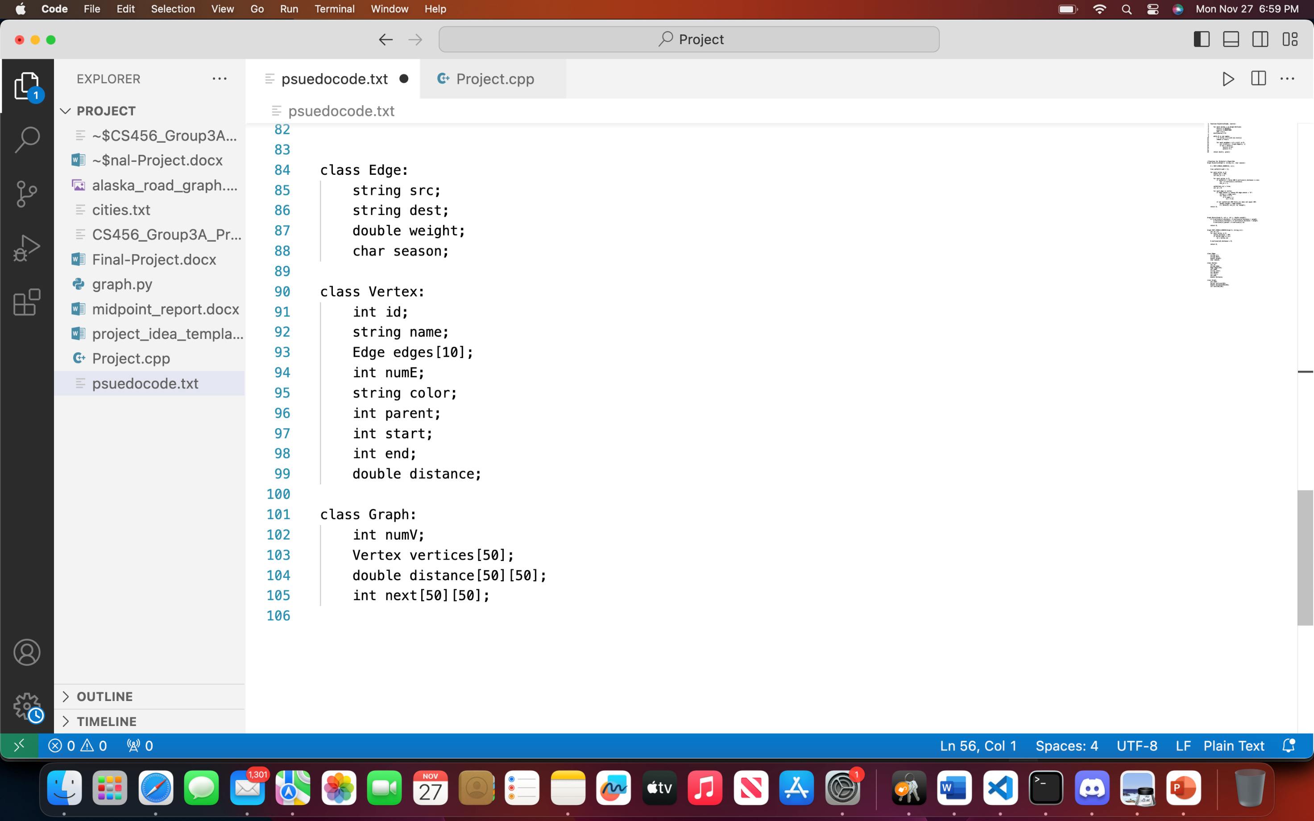

Program Structure
C++ File
Text file/terminal input
Terminal output

Slide 13
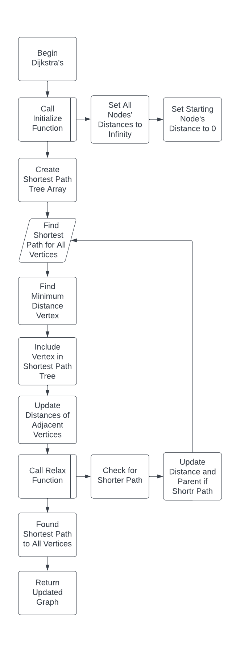
Dijkstra’s Algorithm
Once a starting city is chosen, Dijkstra’s algorithm runs.
Algorithm finds shortest path to every city.
Creates SPT from starting city.
Time Complexity: O(V * E)
Space Complexity: O(V + E)

Slide 14
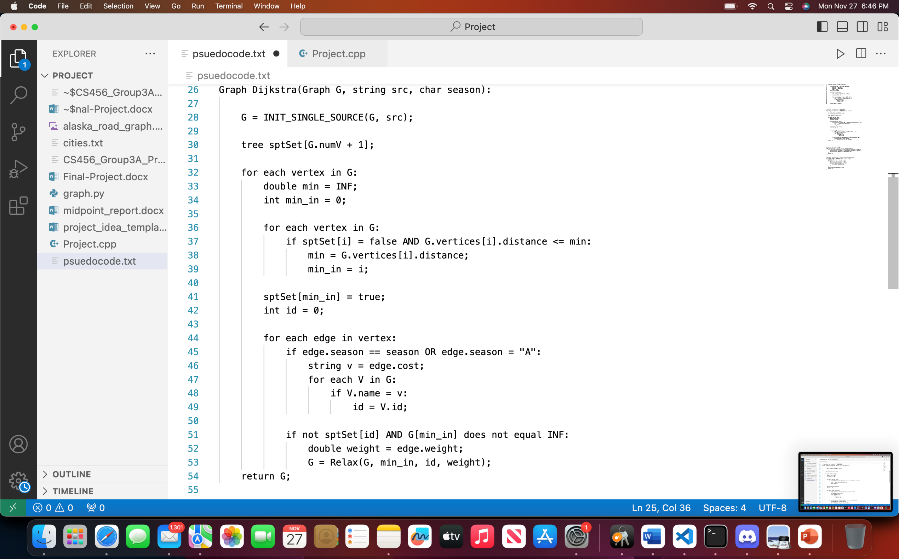
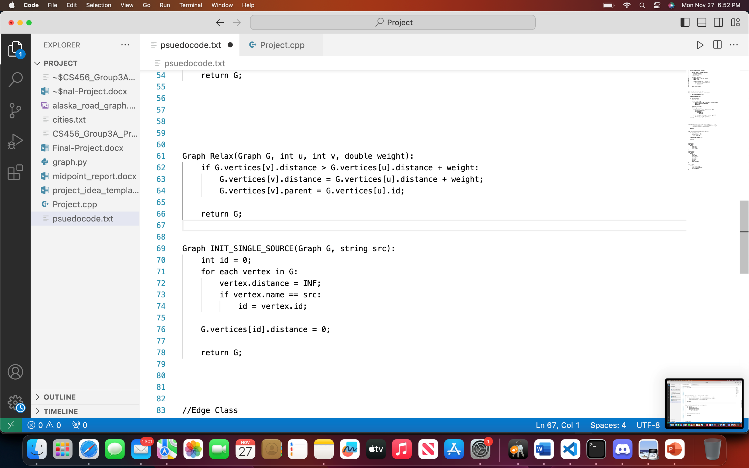

Dijkstra’s Algorithm
Relax()
INIT_SINGLE_SOURCE()

Slide 15
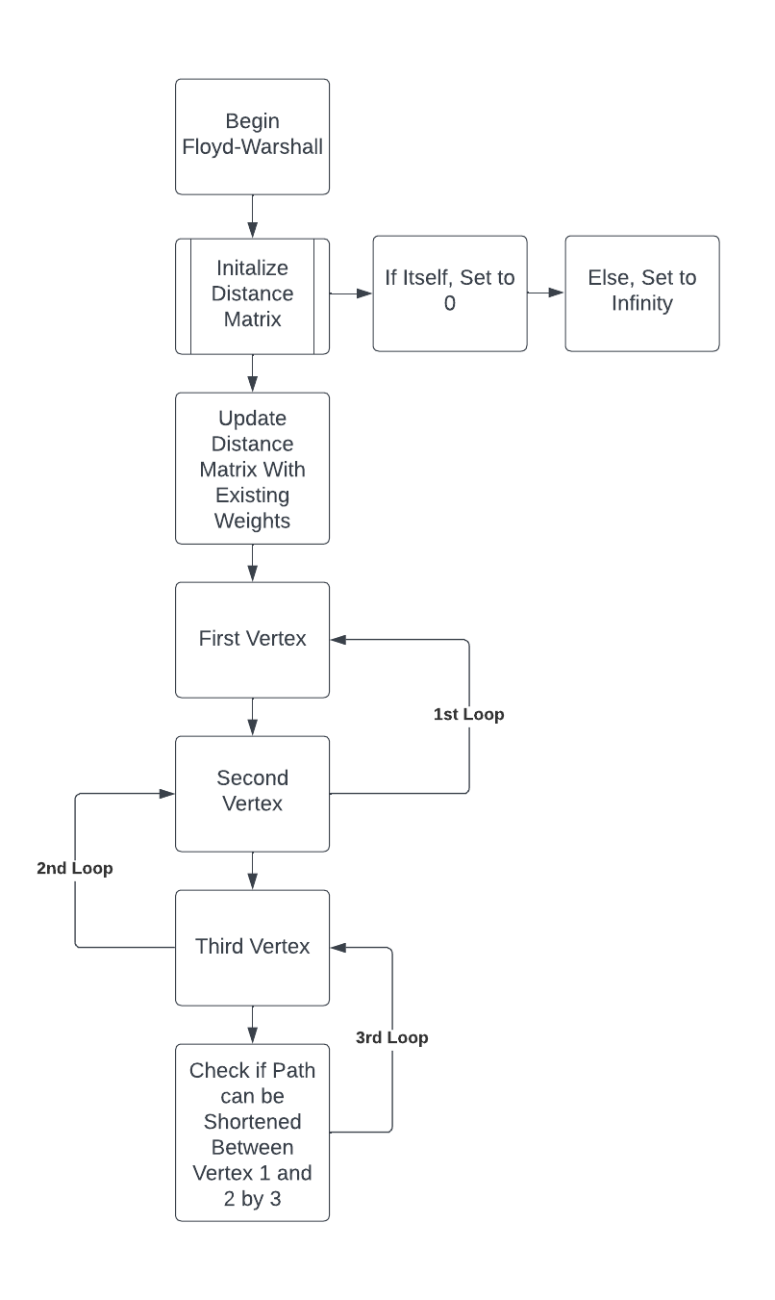
Floyd-Warshall Algorithm
Distance matrix is created.
Update distance matrix accordingly.
Existing edges (weights), to itself (0), or infinity
Check for a shorter path
Time Complexity: O(V³)
Space Complexity: O(V²)

Slide 16
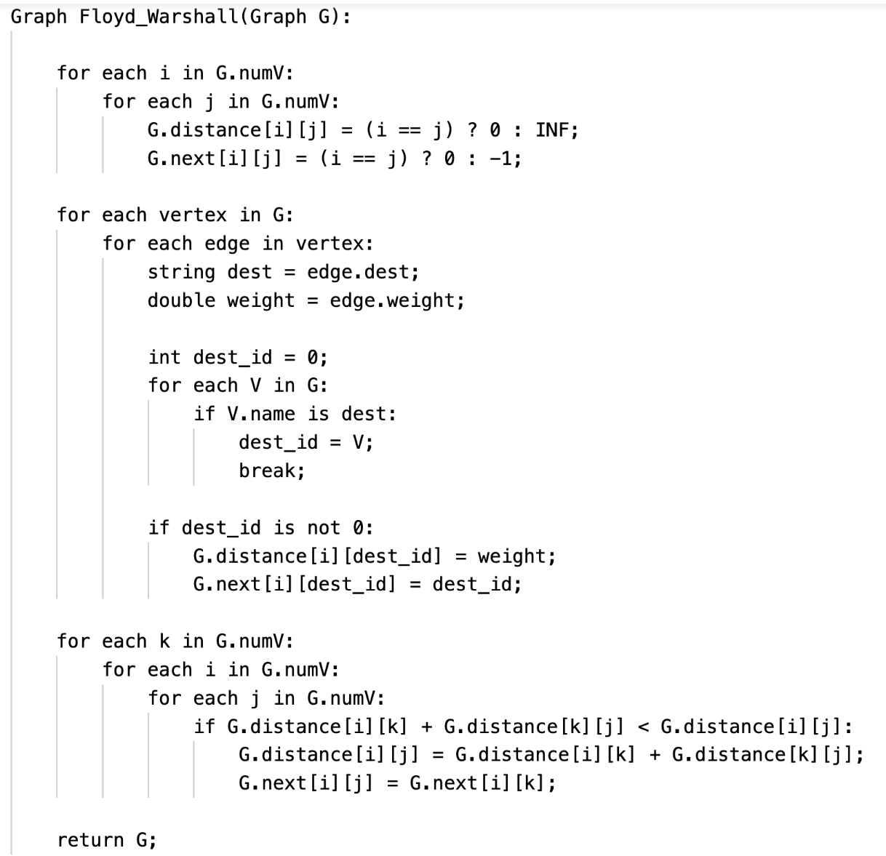
Floyd-Warshall Algorithm

Slide 17
Johnson’s Algorithm
Add a new vertex that has an edge to every other vertex
Reweight edges using Bellman-Ford
Change any negative weights if any exists (N/A)
Run Dijkstra’s Algorithm on every vertex
Efficient since negative edges are not present
The weights are re-adjusted to reflect the original weights
Time Complexity: O(V²logV+VE)
Space Complexity: O(V + E)

Slide 18
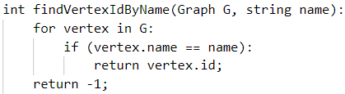
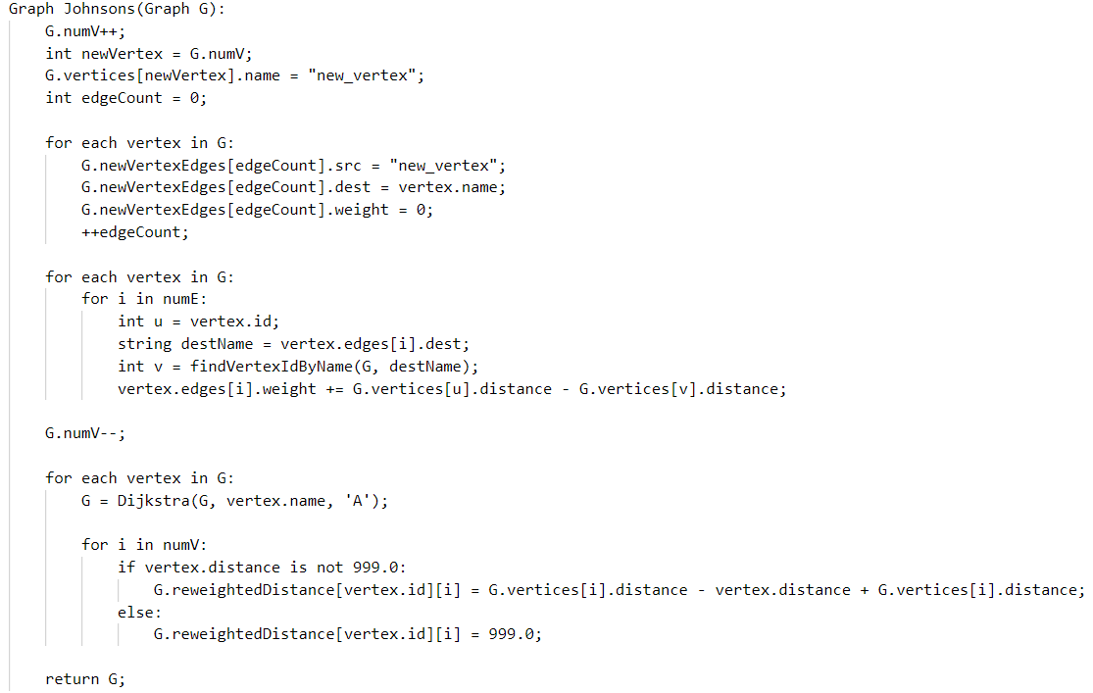
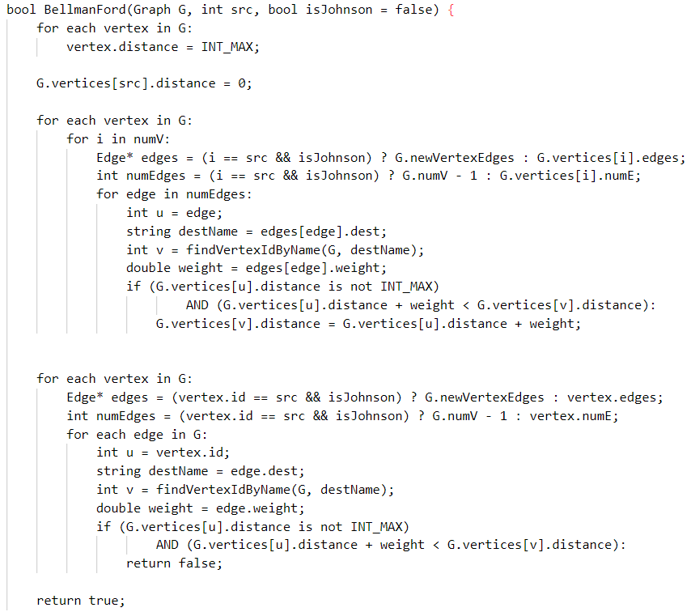
Johnson’s Algorithm

Slide 19
Experiment Design and Metrics
Run several tests using each algorithm
For each test, run both a test for Winter and Summer
Compare Execution Time that the algorithm takes
Compare the adaptability that these algorithms have

Slide 20
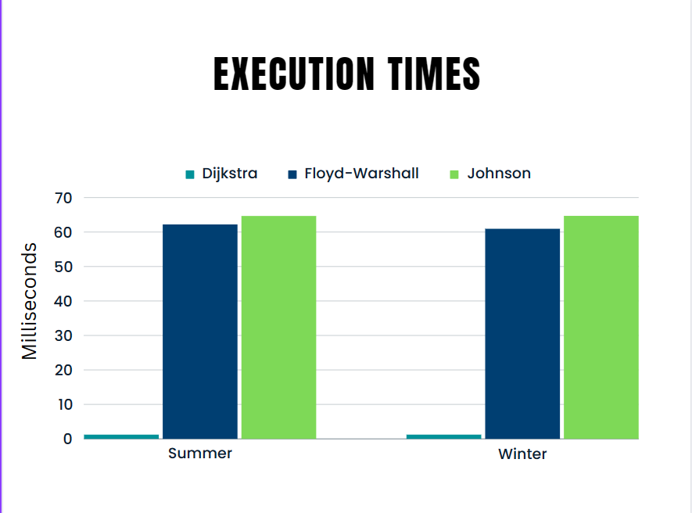
Results
Appears to follow the expected trends for comparison
Drastic difference in times
Single-Source vs. All Pairs
Does the season have any significant affect to execution time?

Slide 21
Results Cont.
Adaptability:
Flexibility:
How difficult is it to choose a different starting or destination city?
Ease of Use:
Does the algorithm require user input, and if so, how much?
Real-Life Scenarios:
How applicable is it to the real-world?
GPS, Physical Mapping, Networking?

Slide 22
Conclusion
We determined the best algorithm for this problem is Floyd-Warshall based on execution time and adaptability.
While execution time is significantly larger, its adaptability and full-completion of all pairs shortest paths make up for the execution time.
Future Work:
Generate larger amounts of data for testing to see if a much larger graph provides more significant details in determining best algorithm.

Slide 23
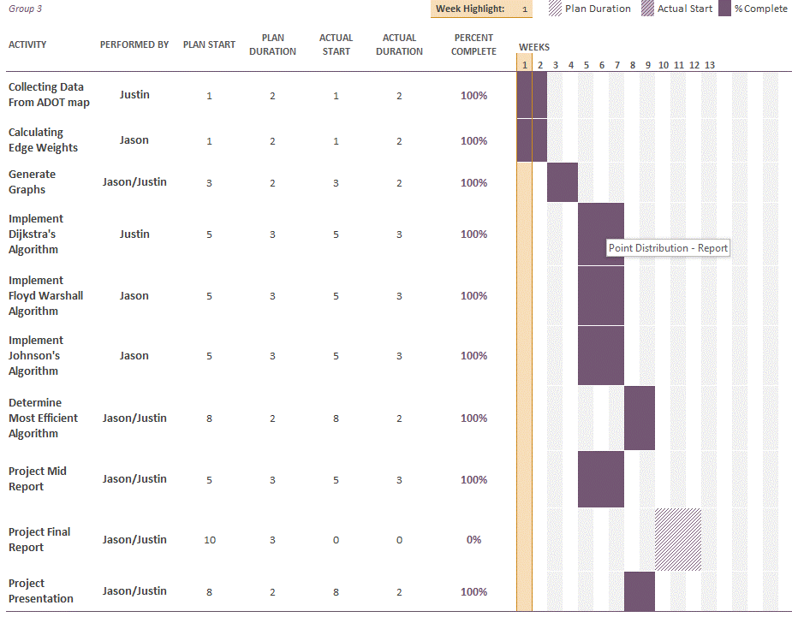
Workflow
12 Weeks of development
Work divided evenly

